Slide 1
Arrays

Slide 2
Arrays
Array – the structure of an identical data type that stored in a continuous memory area. Array has a size – number of array elements.
Each array element has its own number - also called by index.
In C++, element numbering starts from 0, so the last array element number is smaller by 1 than the array size.

Slide 3
Array definition
Array in C++ language can be defined as follows:
element_type array_name[size];
where:
element_type — any C++ data type of array elements such as int, double, and so on. array_name – array name;
size – number of elements.
You can use array element as follows:
array_name[size]
For example, if an array was defined as double A[5]; -
there will be 5 double type elements created:
A[0], A[1], A[2], A[3], A[4].

Slide 4
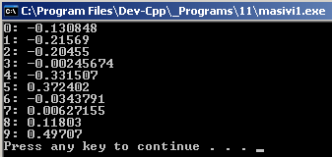
Arrays - example
Fill an array with 10 random numbers in a range [-0.5; 0.5] and output to screen.
int main()
{
const int N = 10;
double a[N];
time_t t;
srand((unsigned) time(&t));
for(int i=0;i<N;++i)
a[i] = rand()/(double)RAND_MAX - 0.5;
for(int i=0;i<N;++i)
cout << i << “: " << a[i] << endl;
system("pause");
return 0;
}

Slide 5
Array initialization
Arrays can be initialized along with definition.
int leap_year[12] =
{
31,29,31,30,31,30,31,31,30,31,30,31
};
or
const int months = 12;
int standard_year[months] =
{
31,28,31,30,31,30,31,31,30,31,30,31
};

Slide 6
Practice
Display all array elements with an even indexes. Find the number of positive elements in an array. Find the max array value. Move the array elements to reverse order without using an additional array. Move the array elements by one position to the right (0. becomes 1st, 1st becomes 2nd,..., the last becomes 0.). The program requires an array containing N integers and outputs which values are more: positive or negative. The program requires an array containing N integers, and outputs if there are an equal values. Create an array that contains Fibonacci sequence first N numbers (1, 1, 2, 3, 5, 8, 13,...)

Slide 7
Multidimensional arrays
Arrays can be two-dimensional (matrix), three-dimensional, etc. The maximum number of dimensions in C++ language is limited to 256 (by C++ 11 standard).
Two-dimensional array (3 rows, 2 columns)
double matrix[3][2];
You can use two-dimensional array element using two indexes
matrix[1][2];

Slide 8

Two-dimensional array example
Fill in array 3x3 with random numbers 0 – 9, and output to screen.
int main()
{
time_t t;
srand((unsigned) time(&t));
const int N=3,M=3;
double a[N][M];
for(int i=0; i<N; i++)
for(int j=0; j<M; j++)
a[i][j] = rand()%10;
for(int i=0; i<N; i++)
{
for(int j=0; j<M; j++)
cout << a[i][j] << " ";
cout << endl;
}
system("pause");
return 0;
}

Slide 9
Two-dimensional arrays Practice
Using the random generator, fill a two-dimensional array10x10 with numbers in the range of 10-99, and display it on the screen. Display the main diagonal values separately. Find the matrix 7x5 each line sum, and save it into a one-dimensional array with a length of 7. Find the matrix 7x5 each column sum, and save it into a one-dimensional array with a length of 5. Using the random generator, fill a two-dimensional array MxN with numbers in the range of 10-99, and display it on the screen. Swap main and adjacent diagonal elements. Display the result on the screen.

Slide 10

Arrays as function arguments
void Init_Array (double a[], int N)
{
for(int i=0; i<N; i++)
a[i] = rand()%10;
}
void Print_Array(double a[], int N)
{
for(int i=0; i<N; i++)
cout << a[i] << " ";
cout << endl;
}
int main()
{
time_t t;
srand((unsigned) time(&t));
const int N=10;
double a[N];
Init_Array(a,N);
Print_Array(a,N);
system("pause");
return 0;
}
7., 20., un 21. the array description requires two arguments - pointer to the beginning of the array, and number of elements.

Slide 11
Pointers
Pointer is a variable that stores memory address.
Adress is a value representing a certain memory location.
May be said that the pointer is a type of reference.
Unlike a reference, it can be defined without the need to be initialized. Defining the pointer: type *variable
int *p //data that has an address of p

Slide 12

Pointers - Example
int main()
{
int z = 10;
int *x; // pointer x definition
x = &z; // pointer x initialization, x now stores address of z
cout << *x << endl;
system("pause");
return 0;
}

Slide 13
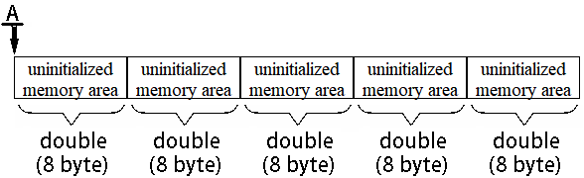
Pointers and Arrays
As was mentioned before: array is the structure of the same data type values that are stored in a continuous memory area. So if an array was defined double A[5];
there will be 5 double type values created:
A[0], A[1], A[2], A[3], A[4].

Slide 14
Pointers and Arrays
This may not be allowed by all programming environments. But is supported in C++.
When the array is defined double A[5];
a pointer to its storage place will be created.
Compiler rebuilds syntax at compilation as
double A[5]; to double *A;
A[0]=4; to *A=4;
A[1]=8; to *(A+1)=8; where +1 is +1 double size, or +8bytes
…
A[4]=5; to *(A+4)=5; where +4 is +4 double size, or +(4*8)bytes
An interesting fact related to syntax, if A[2] is *(A+2) and *(A+2)=*(2+A) than A[2] is the same that 2[A], and you really can write like so :)
Another interesting fact – by defining a pointer
int *x=5; you can write as
*(x+1)=7; *(x+2)=15; etc.
It will also work in this way because addressing of the memory area takes place, but DON’T USE it because the data will be written in a non-reserved memory location and there can be stored some other program data!!!

Slide 15

Multidimensional arrays as function arguments
void Init_Array (double a[][4], int N)
{
for(int i=0; i<N; i++)
for(int j=0; j<4; j++)
a[i][j] = rand()%10;
}
void Print_Array(double a[][4], int N)
{
for(int i=0; i<N; i++)
{
for(int j=0; j<4; j++)
cout << a[i][j] << " ";
cout << endl;
}
}
1st example
Fill an array 3x4 with random numbers in a range of 0-9 and output to the screen.
int main()
{
time_t t;
srand((unsigned) time(&t));
const int N=3;
const int M=4;
double a[N][M];
Init_Array(a,N);
Print_Array(a,N);
system("pause");
return 0;
}
and 8. All dimensions are mandatory except the first.
PROBLEM – Functions are no longer universal.

Slide 16

Multidimensional arrays as function arguments
void Init_Array (int *a, int N, int M)
{
for(int i=0; i<N*M; i++)
*(a+i) = rand()%10;
}
void Print_Array(int *a, int N, int M)
{
for(int i=0; i<N*M; i++)
{
cout << *(a+i) << " ";
if ((i+1)%M==0) cout << endl;
}
cout << endl;
}
2nd example
Fill an array 3x4 with random numbers in range of 0-9 and display on the screen.
int main()
{
time_t t;
srand((unsigned) time(&t));
const int N=3;
const int M=4;
int a[N][M];
Init_Array(*a,N,M);
Print_Array(*a,N,M);
system("pause");
return 0;
}
, 3., 7., 9. There is no dimension in memory, everything is stored in a consecutive memory area. You need to know the total number of items and take care of output formatting. , 24. Function should now pass the pointer to the beginning of the array. PROBLEM SOLVED Functions are universal again.

Slide 17
Arrays as arguments. Practice.
Write a function
int Search (int A[], int n, int x),
that in array int A[n] is searching for an element which value is x. Function returns element's index if value is found, or -1 if there is no such value in the array. 2. Write a function
int CountMax (int A[], int n)
that calculates how many times the maximum value encountered in an array. The function must perform a single array traversal.

Slide 18
Structured variables

Slide 19
Structure structure
structure combines several variables-fields (possibly different types). Definition of a structure:
struct structure_name
{
type1 field1;
...
typeN fieldN;
};
Example:
struct human
{
char name[25];
int age;
};

Slide 20
Structure structure
Initializing of a structure:
structure_name variable_name;
Example:
human h;
Using the structure field:
variable_name.field
Example:
human h.name;
human h.age;

Slide 21
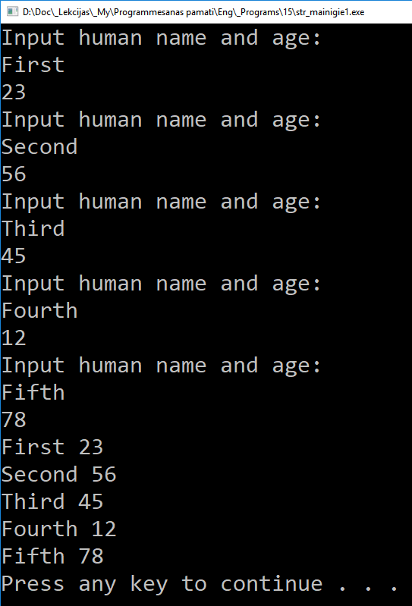
Structure structure
struct human
{
char name[25];
int age;
};
int main()
{
human humans[5];
for (int i=0; i<5; i++)
{
cout << "Input human name and age: " << endl;
cin >> humans[i].name >> humans[i].age;
}
for (int i=0; i<5; i++)
cout << humans[i].name << " " << humans[i].age << endl;
system("pause");
return 0;
}

Slide 22
Practice
Describe the structure with the specified fields:
Employee: surname, position and salary.
Describe the constant N and array A containing N records. Initialize it with any values. Than program ask a surname and displays all fields of the corresponding record.

